Slide 1
You know more French than you think!

Slide 2
Borrowing
About 30% of English words have a French origin.

Slide 3
English words spelled like French but pronounced differently
Colours
Beige
Orange
Violet
Turquoise

Slide 4
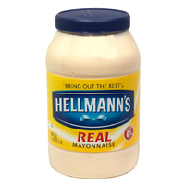
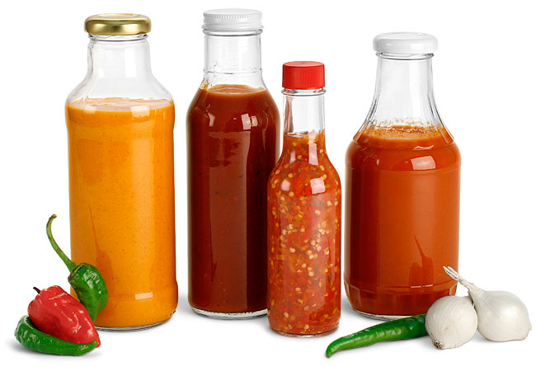
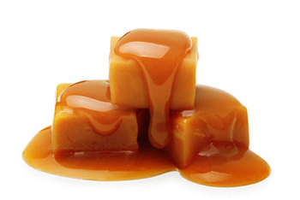
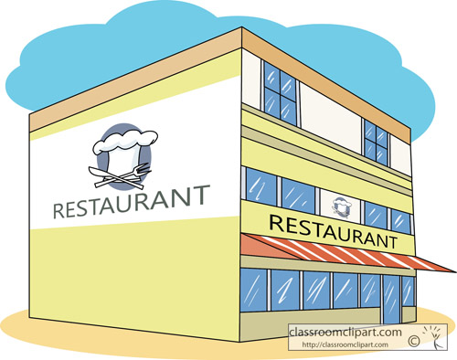
English words spelled like French but pronounced differently
Cooking
Sauce
Mayonnaise
Restaurant
Caramel

Slide 5
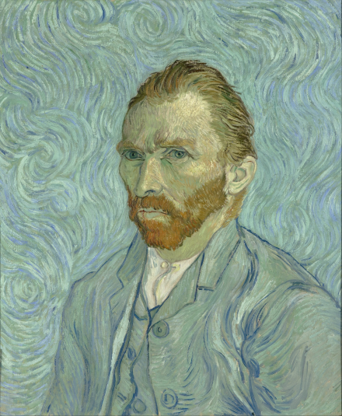
English words spelled like French but pronounced differently
Arts
Art
Portrait
Note

Slide 6
English words spelled like French but pronounced differently
Law / Politics / Economics
Finance
Justice
Alliance
Commerce

Slide 7
English words that come from French phrases
Some English words use a French phrase (more than one word) and transform it into one word.
Here are some examples.

Slide 8
English words with French origins but spelled differently
Colours
English | French | Colour
Blue | Bleu
Purple | Pourpre
Scarlet | Écarlate (escarlate)

Slide 9
English words with French origins but spelled differently
Months
English | French
January | Janvier
November | Novembre
March | Mars
July | Juillet

Slide 10
English words spelled like French but pronounced differently
Cooking
English | French
Veal | Veau
Beef | Boeuf
Pork | Porc
Mutton | Mouton
English | French
Pastry | Pâtisserie (pastisserie)
Mustard | Moutarde
Cream | Crème

Slide 11
English words spelled like French but pronounced differently
Arts
English | French
Stage | Étage (estage)
Music | Musique
Dance | Danse
Theatre | Théâtre
English | French
Author | Auteur
Melody | Melodie
Brush | Brosse

Slide 12
English words spelled like French but pronounced differently
Law / Politics / Economics
English | French
Money | Monnaie
State | État (estat)
Treaty | Traité
Tax | Taxe
English | French
Government | Gouvernement
Judge | Juge
Attorney | Attorné

Slide 13
Why does English have all these French words?
The borrowing of words is due to contact between two languages. In the case of English, there were a lot of invasions and wars to create that contact.
The Norman (French) conquest had a huge impact on the English language.

Slide 14
English words that borrows from French at two different periods of time
English | Norman | French
Guardian Warden | Warder (to keep) | Garder (to keep)
Reward Regard | Reward (a look) | Regard (a look)
Wallop Gallop | Walop (fast pace horse) | Galop (fast pace horse)
Hostel Hôtel | Hostel (a hotel) | Hôtel (a hotel)

Slide 15
French words borrowed from English
French | English
Bol | Bowl
Boss | Boss
Canette | Canned
Compiler | To compile
Fan | Fanatic
Informel | Informal
French | English
Item | Item
Nominer | To Nominate
Parking | Parking
Reporter | A Reporter
Shampooing | Shampoo
Tank | Tank

